Slide 1
Electric motors
Single phase Induction motors:
Double revolving field theory and principle of operation.
Construction and operation of split-phase,
capacitor start,
capacitor run,
and shaded pole motors.
Comparison of single phase motors and applications.

Slide 2
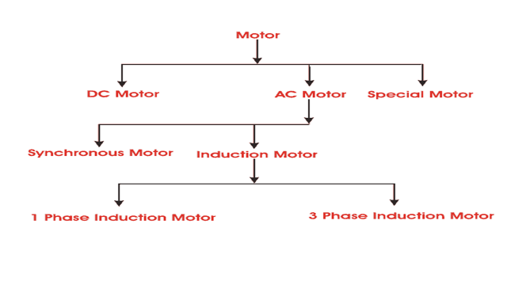
Classification of electric motors

Slide 3
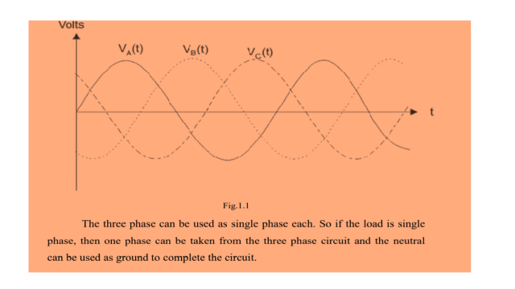
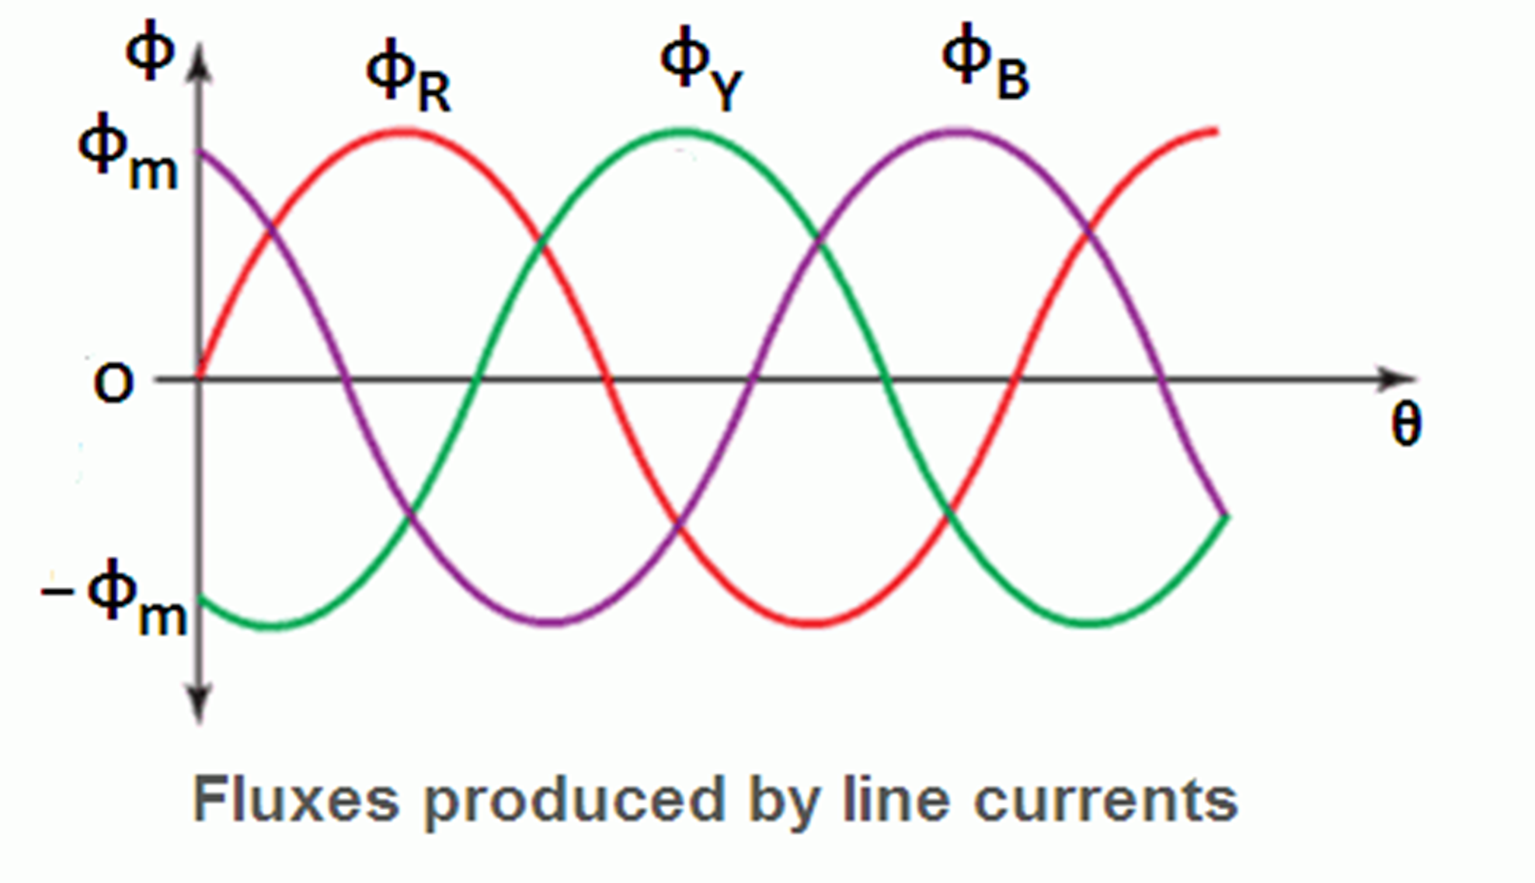
How rotating magnetic field is produced?

Slide 4
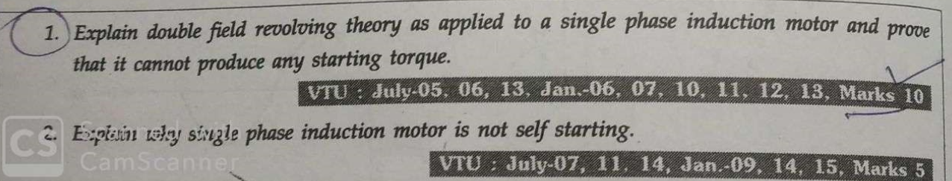

Slide 5
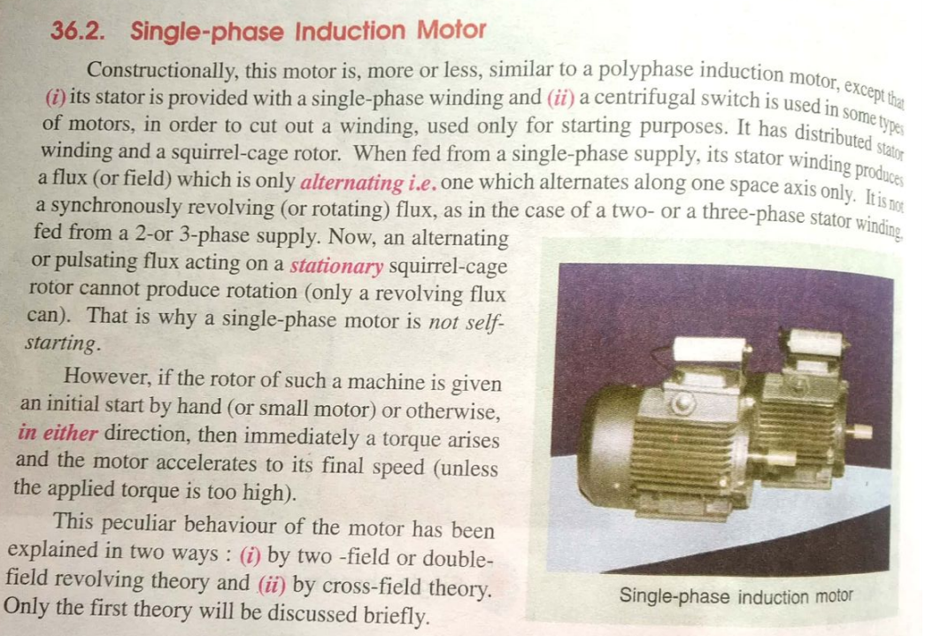

Slide 6
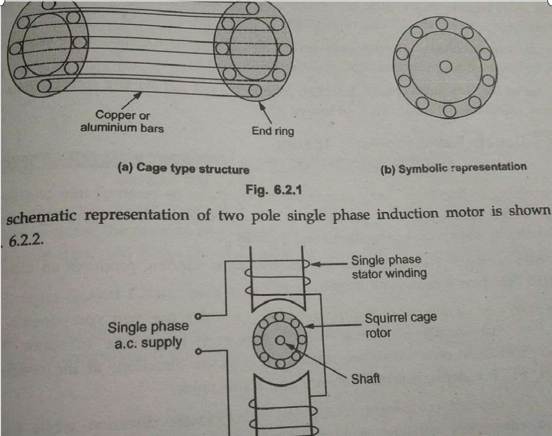
Introduction to single phase Induction motors

Slide 7
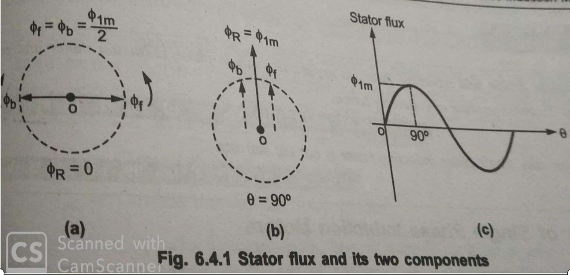
Double field revolving theory
This theory makes use of the idea that an alternating uni - axial quantity can be represented by 2 appositively rotating vectors of half magnitude, accordingly sinusoidal flux can be represented by 2 revolving fluxes each equal to half of the value of alternating flux and each rotating synchronously Ns(120f/p) in opposite direction as shown in fig below.

Slide 8
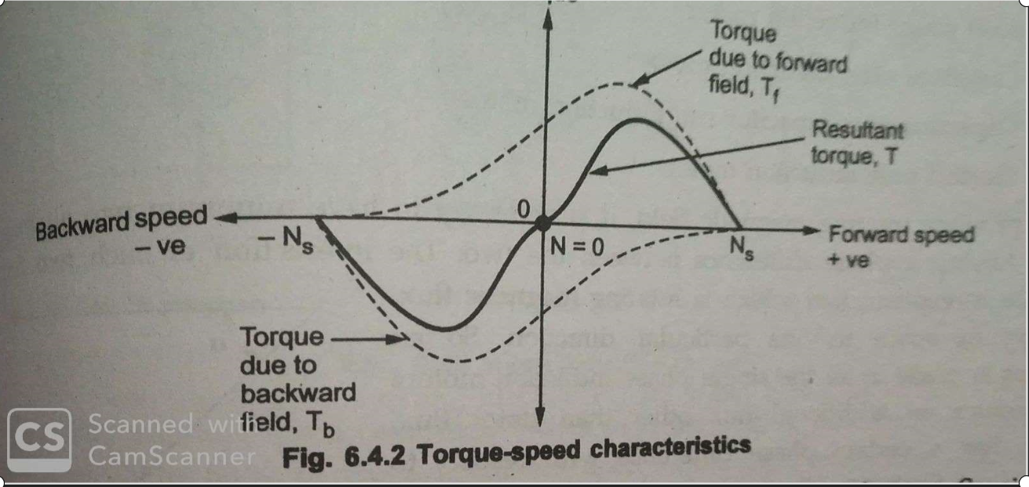
Double field revolving theory-continued…………

Slide 9
Types of single phase induction motors

Slide 10
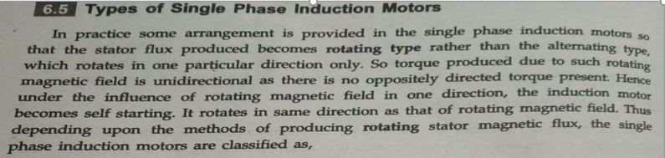

Slide 11
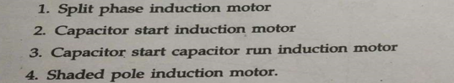
Types of single phase induction motor

Slide 12
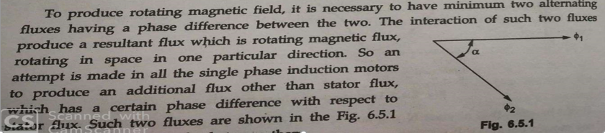

Slide 13
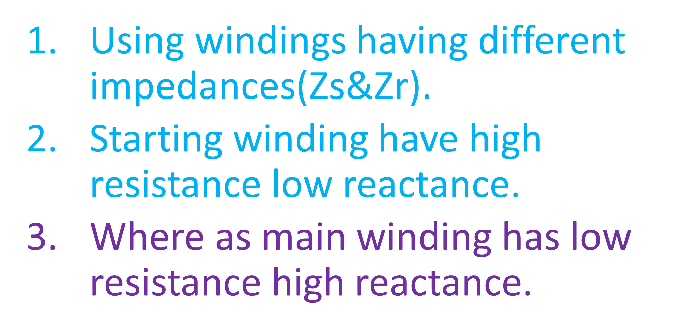
Split phase IM
Using windings having different impedances(Zs&Zr).
Starting winding have high resistance low reactance.
Where as main winding has low resistance high reactance.

Slide 14
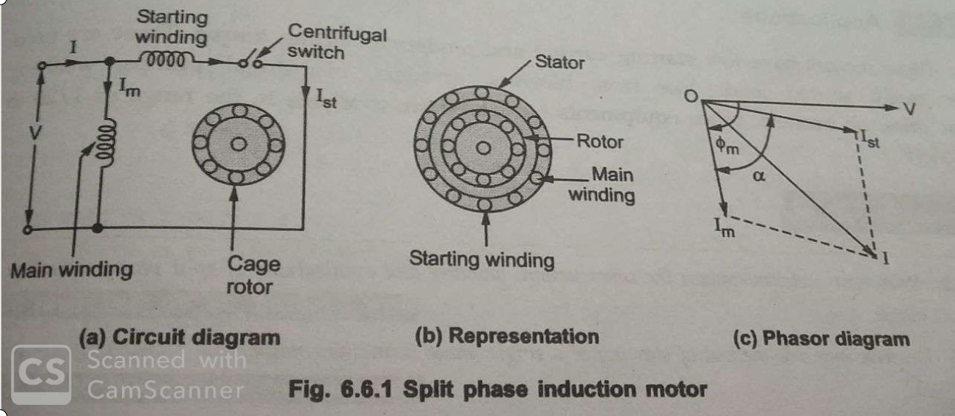
Split phase induction motor

Slide 15
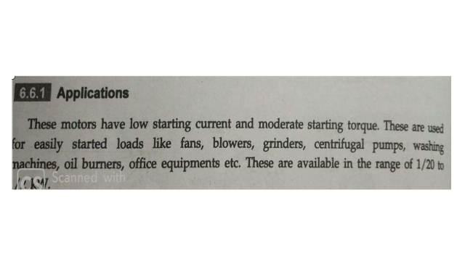
applications of split phase induction motor

Slide 16
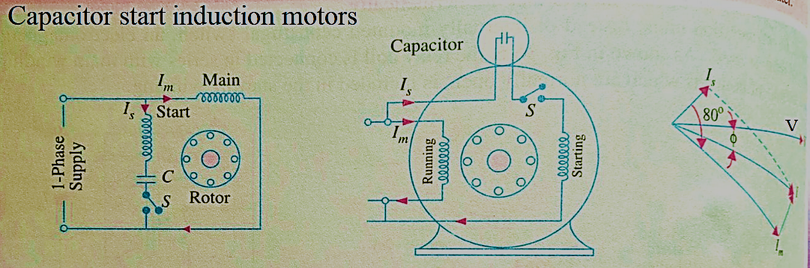

Slide 17
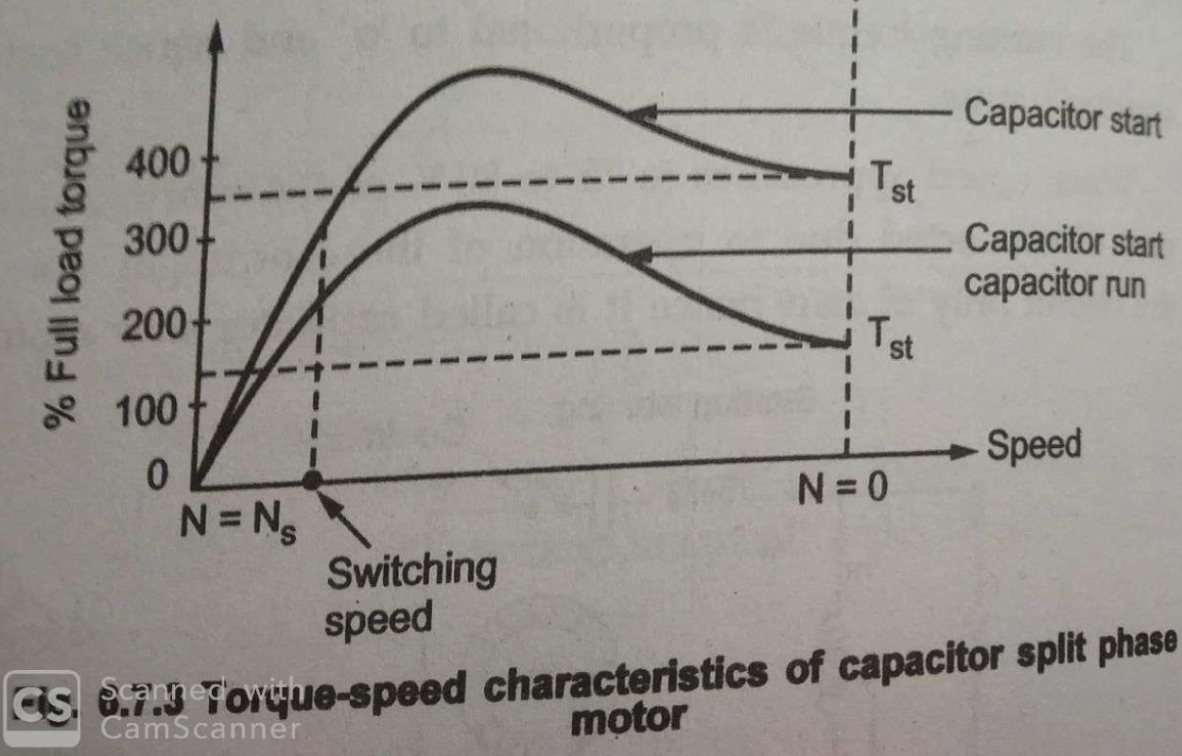
Torque speed characteristics of Capacitor start induction motor

Slide 18
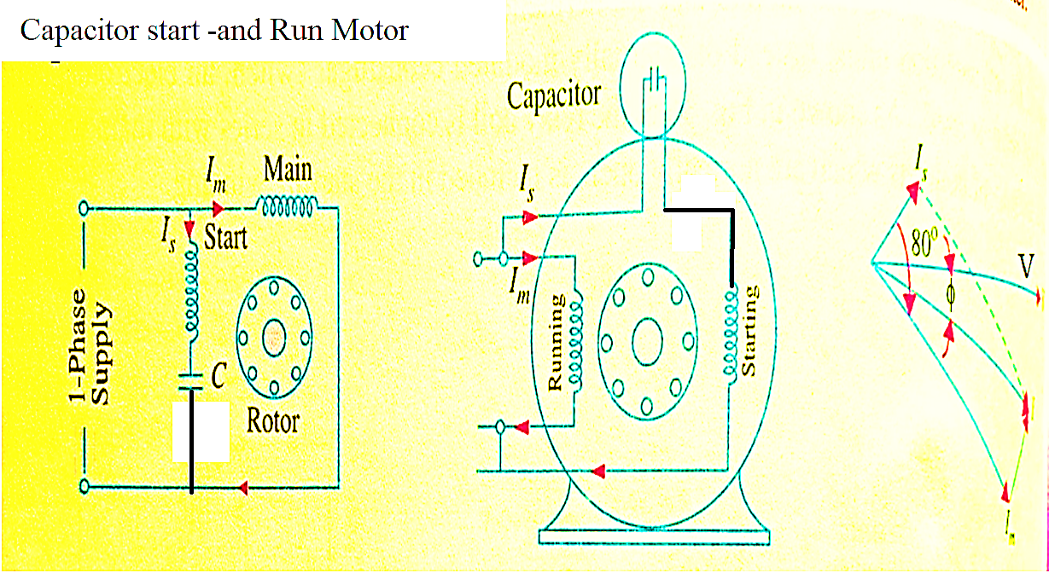
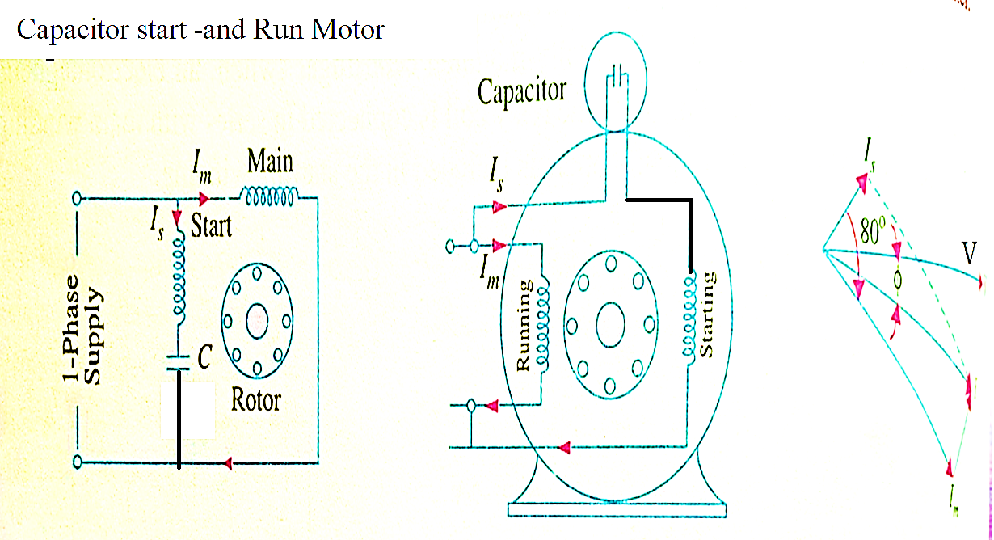

Slide 19
Capacitor start and Run motors
Similar to capacitor start motors, except starting winding is connected all the time parallel to Running winding
Centrifugal switch is not required.
Advantages:
Improvement in over load capacity of the motor(25%)
Higher power factor
Higher efficiency &pf, ability to start heavy loads
Quieter running of the motor which is so much desirable for small drives in offices and labs.
Types of capacitor run single phase induction motors
Single value capacitor run motor
Two value capacitor run motors
Applications: compressors and fire strokers

Slide 20
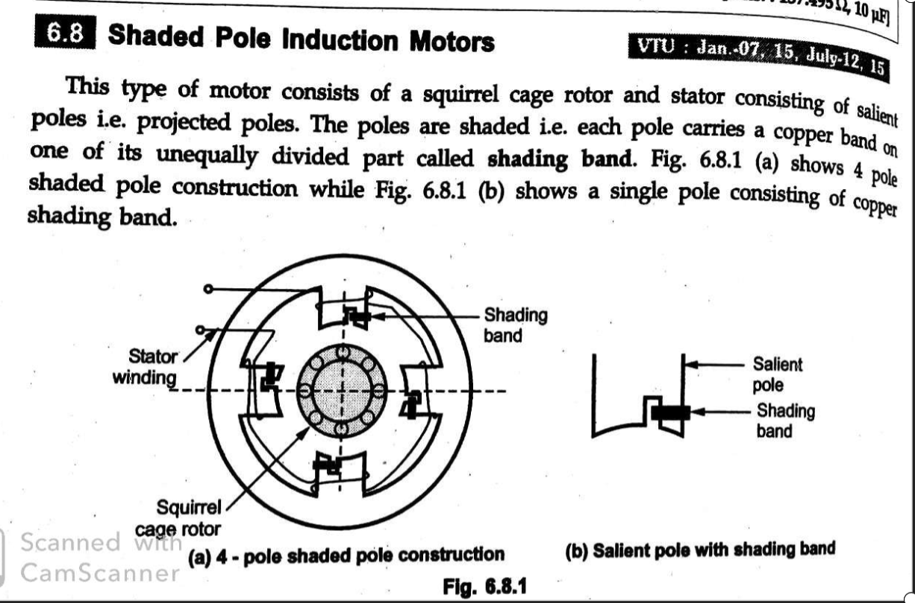
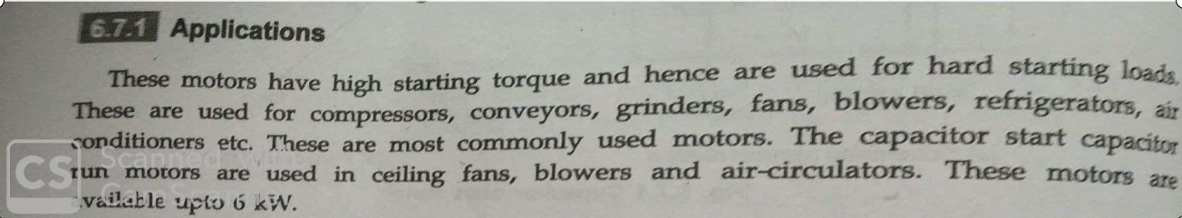

Slide 21
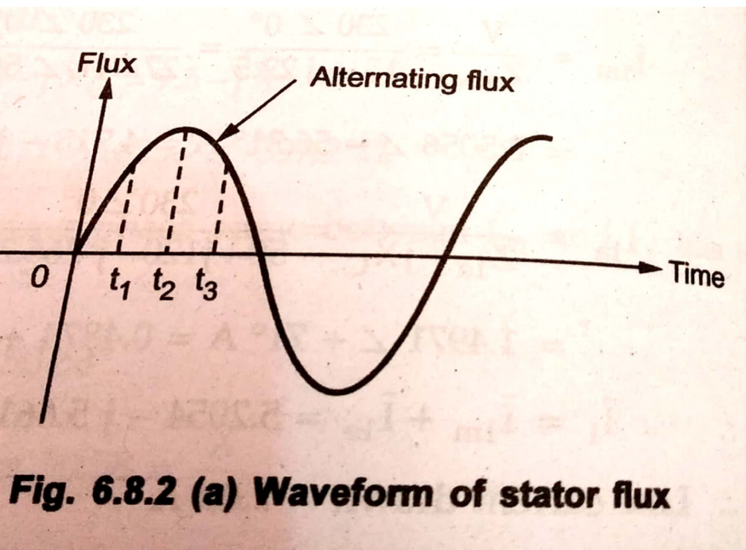

Slide 22
Shaded pole type single phase induction motor
In this type of single phase induction motor, the necessary phase splitting is done by induction.
These motors have salient pole on stator and a squirrel cage rotor
The laminated pole is used in this type of motor
The laminated pole has a slot cut across the laminations across 1/3 distance from one edge.
Around the small part of the pole is placed a short circuited copper coil called shading coil. This part is known as shaded part and other part is known as un shaded part.
When an ac current is passed through field winding surrounding the whole pole, the axis of the pole shifts from unshaded part to the shaded part, this resembles the actual movement of pole

Slide 23
Shaded pole type single phase induction motor
Exciting current is rapidly increasing from 0 to A.
This will produce an emf in the shading coil due to transformer action as shading coil is of low resistance.
A large current will setup in such a direction to oppose the rise of exciting current. Hence flux shift from unshaded part to shaded part.
Now exciting current is near to its peak value A to B here change in exciting current is very slow, practically no volt no current in the shading coil.so the magnetic axis shifts to the center of the pole.
Now the exciting current is rapidly decreasing from B to C.
this again set the induced current in the shading coil by transformation action. This current will flow to oppose the decrease in current. Due to this flux strengthens in shaded part of the pole.
Consequently the magnetic axis shift to the middle part of the shaded pole.

Slide 24
As per the discussion,
During positive half cycle of the exciting current,
N pole shifts along the pole from the unshaded to the shaded part.
During negative half cycle of the exciting current south pole trials along.
This resembles the actual movement of poles.
Rating of shaded pole motors available 1/250 HP to 1/6 HP
Advantages:
very cheap, simple construction,extreamly rugged, reliable &cheap
Disadvantages:
Low starting torque,
Very little over load capacity
Low efficiency (5 to 35%)

Slide 26
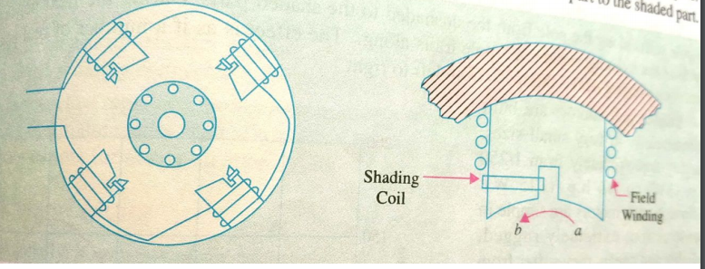

Slide 27
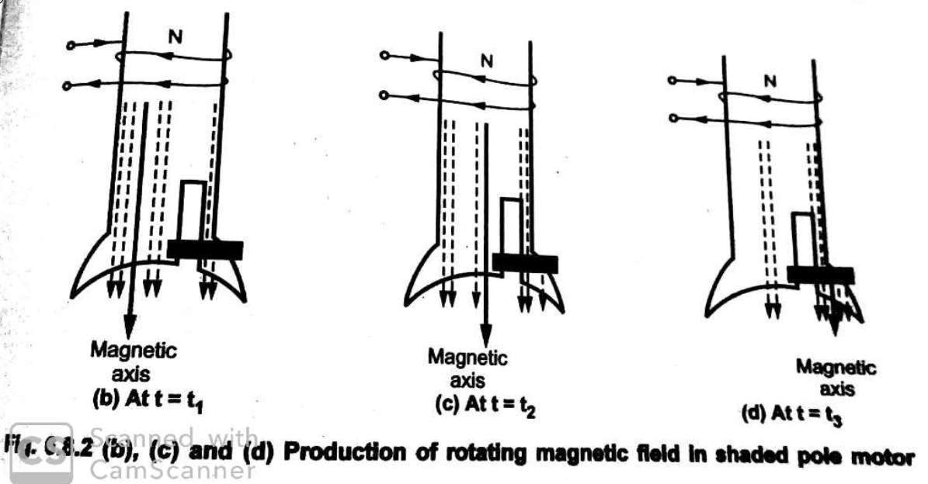

Slide 28
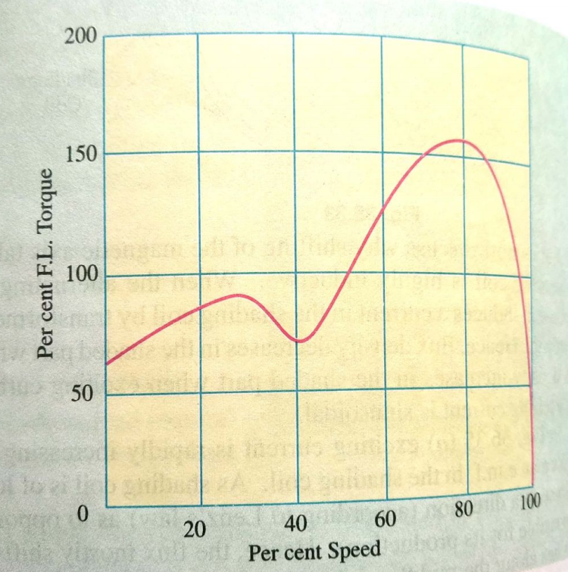

Slide 29
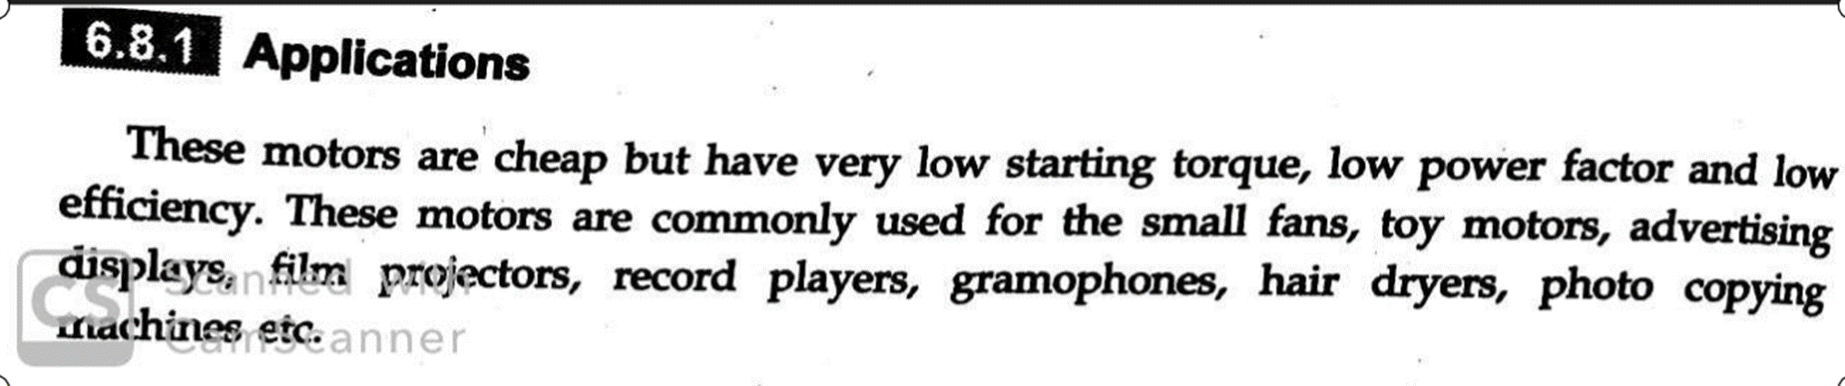
Applications of shaded pole induction motor

